Slide 1
Computer Vision
Exploration & feature engineering

Slide 2
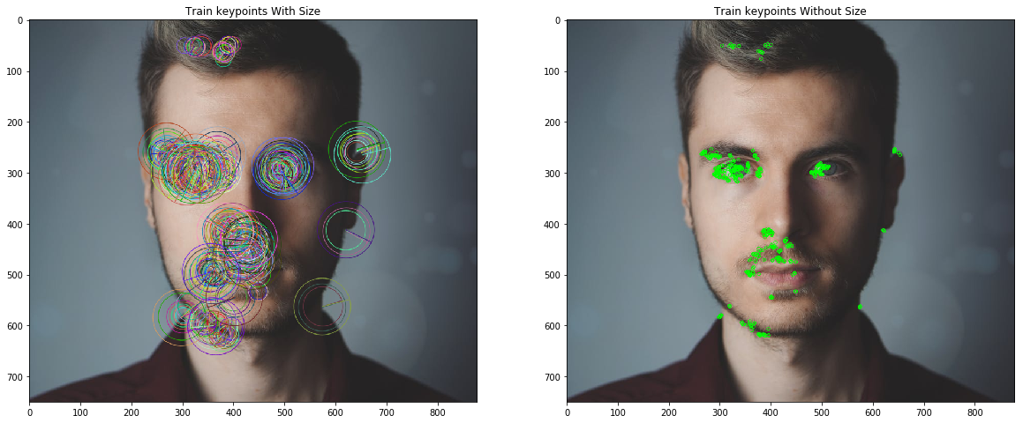
Plan
Data quality
Visualize
Aspect ratio and size
Label composition
Datasets comparison
Normalization & transformation
Feature engineering
SIFT
ORB
Dimensionality reduction
PCA
t-SNE
Notes:
Normization : https://stats.stackexchange.com/questions/211436/why-normalize-images-by-subtracting-datasets-image-mean-instead-of-the-current
Data quality: https://neptune.ai/blog/data-exploration-for-image-segmentation-and-object-detection
Feature: https://towardsdatascience.com/image-feature-extraction-traditional-and-deep-learning-techniques-ccc059195d04

Slide 3
Data quality
Can I do my job with it ?
Can I get around with it ?

Slide 4

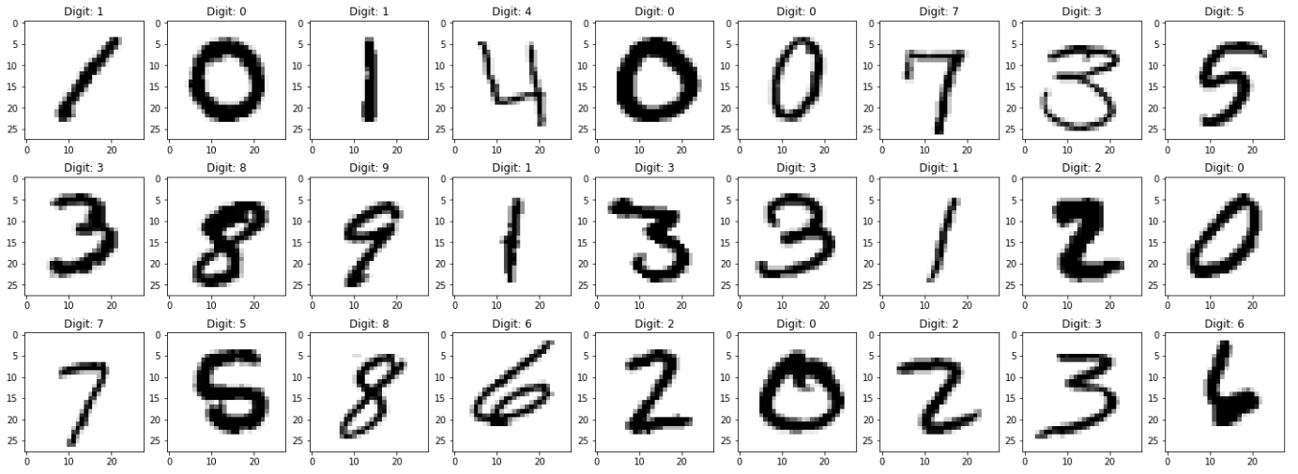
Visualize
Missing labels (mixed datasets)
Wrong labeling
Outliers
Visual inspection
Matplotlib / openCV
HTML renderer
Test each image path
Images / label

Slide 5
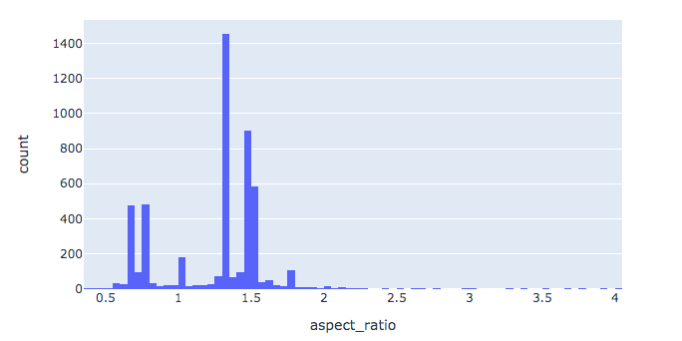
Aspect ratio and size
Size or definition: W X H (1600 X 900)
Aspect ratio: W / H (16 / 9)
Distribution (total and per label)
Unimodal: resizing or not
Bimodal: resizing
Multimodal: batch training or else
Anchor box size per label
Destructive resizing
Padding method
Visual inspection

Slide 6
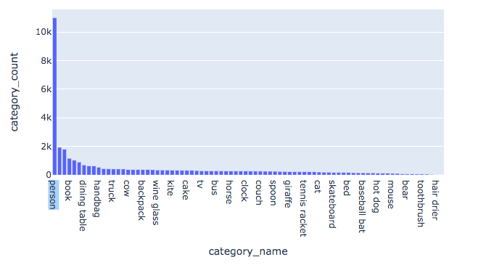
Label composition
Oversample
Downsample
Update dataset
Balance model weights

Slide 7
Datasets comparison
What’s your target model (architecture) ?
Best performance obtained on which dataset ?
Your dataset
Standard dataset
Image sizes
Aspect ratios
Anchor box sizes

Slide 8
Normalisation & transformation
Increase training speed
Increase efficiency and robustness
Pixel Normalization: pixel values range 0-1.
Pixel Centering: pixel values have a zero mean.
Pixel Standardization: pixel values have a zero mean and unit variance (gaussian distrib).
Per image / batch / dataset
Histogram equalization: improve feature appearance by increased contrast
Crop / zoom / rotations: generate more or less possibilities
Denoising: improve feature detection
This is all theory
Look for proofs
Notes:
https://machinelearningmastery.com/how-to-normalize-center-and-standardize-images-with-the-imagedatagenerator-in-keras/
https://machinelearningmastery.com/how-to-manually-scale-image-pixel-data-for-deep-learning/
https://stats.stackexchange.com/questions/185853/why-do-we-need-to-normalize-the-images-before-we-put-them-into-cnn

Slide 9
Feature Engineering
Algorithms

Slide 10
Feature notions
Characteristics
Algorithms
Feature = interesting image zones
Characteristics:
Repeatable
Distinct
Local (minimum neighbors impact)
Based on gradient disruption
Detectors: HARRIS, FAST
Descriptors: BRIEF
Both: SIFT, ORB, Conv layer
Notes:
https://data-flair.training/blogs/keras-vs-opencv/

Slide 11
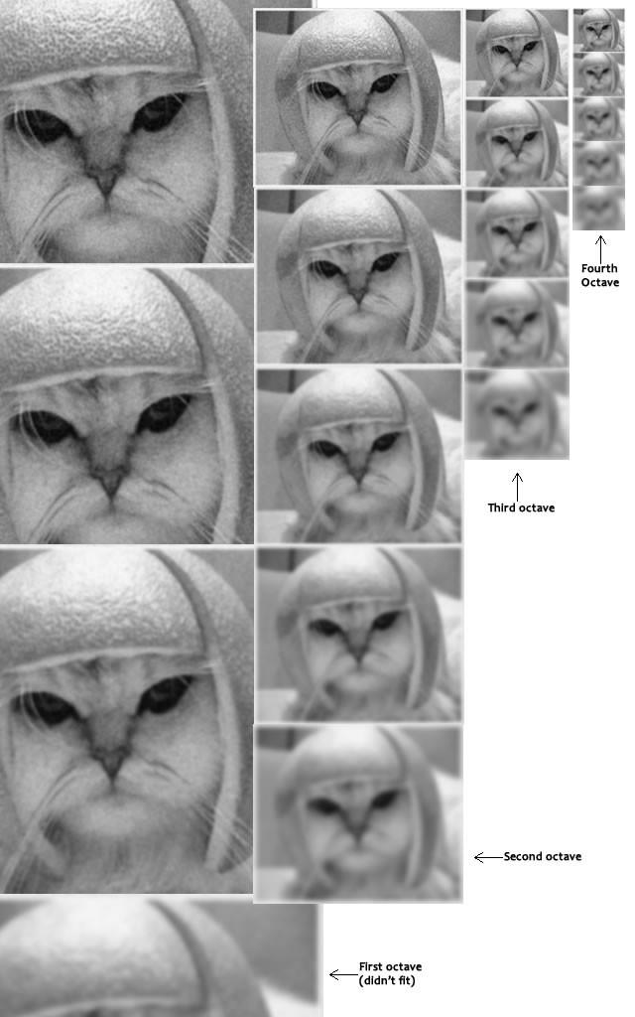
Scale Invariant Feature Transform (SIFT)
Feature Detector
Scale space
Notes:
https://medium.com/data-breach/introduction-to-sift-scale-invariant-feature-transform-65d7f3a72d40

Slide 12
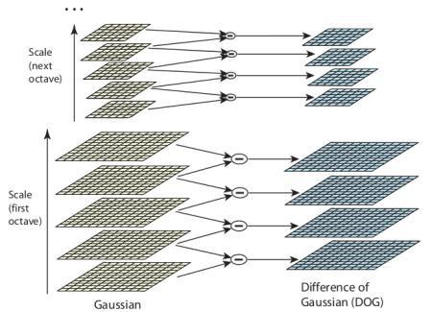
Scale Invariant Feature Transform (SIFT)
Detector
Scale space
Keypoints (extremes in Gaussian differences)
Descriptor
Vectors of n dimensions
Orientation
Brightness normalisation
Feature matching

Slide 13
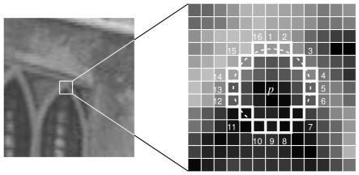
Oriented FAST and Rotated BRIEF (ORB)
Open source
Fastest
Most efficient
Detector (FAST)
> 8 pixels darker / lighter = feature
Notes:
https://medium.com/data-breach/introduction-to-orb-oriented-fast-and-rotated-brief-4220e8ec40cf
https://dsp.stackexchange.com/questions/1305/binary-robust-independent-elementary-features-brief-understanding

Slide 14
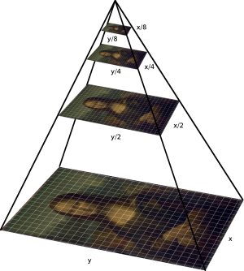
Oriented FAST and Rotated BRIEF (ORB)
Detector (FAST)
> 8 pixels darker / lighter = feature
Orientation based on multiscale pyramid
Notes:
https://medium.com/data-breach/introduction-to-orb-oriented-fast-and-rotated-brief-4220e8ec40cf
https://dsp.stackexchange.com/questions/1305/binary-robust-independent-elementary-features-brief-understanding

Slide 15
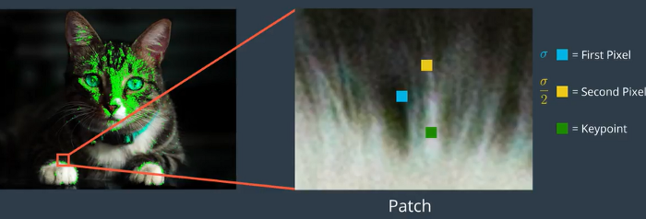
Oriented FAST and Rotated BRIEF (ORB)
Descriptor (BRIEF)
Binary vector of 128 to 512 bits
Feature matching
Notes:
https://medium.com/data-breach/introduction-to-orb-oriented-fast-and-rotated-brief-4220e8ec40cf
https://dsp.stackexchange.com/questions/1305/binary-robust-independent-elementary-features-brief-understanding

Slide 16
Dimensionality Reduction
Why and how ?

Slide 17
Purpose
1 pixel = 1 variable
64 x 64 pixels = 4096 variables !
Features detectors = too many variables !
Can we get rid of some of them ?
Code exemple: https://www.kaggle.com/hamishdickson/preprocessing-images-with-dimensionality-reduction

Slide 18
Variance
Example
How far from the mean
Low = all points are similar
High = Very different points
Assumptions:
Background and object = high variance
I can delete some pixels and keep high variance
Vector(10): 2, 3, 3, 3, 4, 4, 4, 5, 5, 6
Variance = s² = 1.4333333
Mean = 3.9
Vector(9): 2, 3, 3, 3, 4, 4, 5, 5, 6
Variance = s² = 1.6111111
Mean = 3.9
14.3%
Vector(9): 2, 3, 3, 3, 4, 4, 4, 5, 5
Variance = s² = 1
Mean = 3.7
28.6%
Notes:
Variance is a measure of dispersion of data points from the mean. Low variance indicates that data points are generally similar and do not vary widely from the mean.

Slide 19
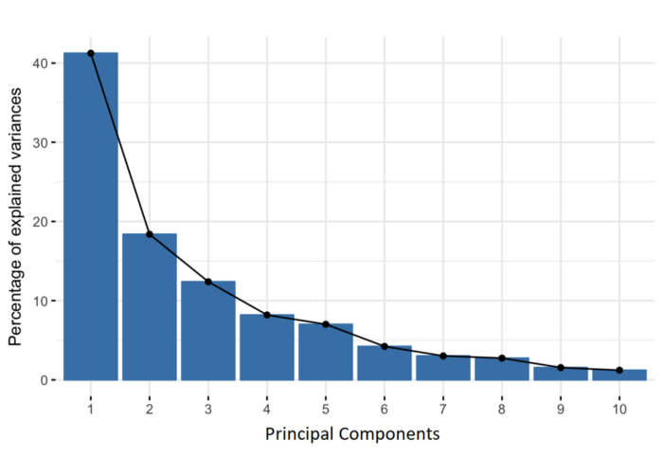
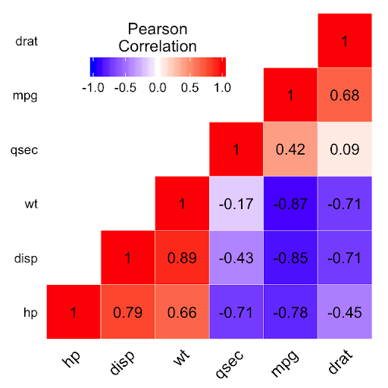
Principal Component Analysis
Reduce the number of variables of a data set, while preserving as much information as possible
Requires dataset pixel standardization
Notes:
https://www.kaggle.com/hamishdickson/preprocessing-images-with-dimensionality-reduction
https://builtin.com/data-science/step-step-explanation-principal-component-analysis
Principal components are new variables that are constructed as linear combinations or mixtures of the initial variables. These combinations are done in such a way that the new variables (i.e., principal components) are uncorrelated and most of the information within the initial variables is squeezed or compressed into the first components. So, the idea is 10-dimensional data gives you 10 principal components, but PCA tries to put maximum possible information in the first component, then maximum remaining information in the second and so on, until having something like shown in the scree plot below.

Slide 20
t-SNE
Steps:
Probability of difference in high dimension
Probability of difference in low dimension
Hyperparameters
Computationally expensive
UMAP:
Slightly better projection than t-SNE
Much faster
Notes:
https://towardsdatascience.com/t-sne-clearly-explained-d84c537f53a
https://pair-code.github.io/understanding-umap/

Slide 21
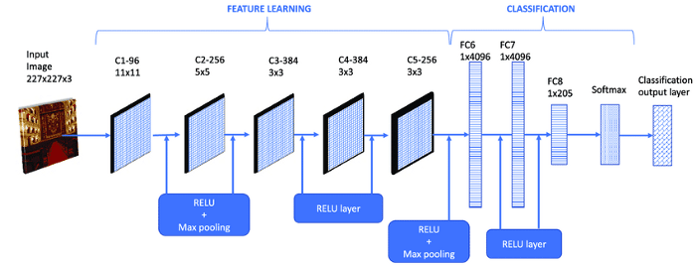
Use Case
Visualization
Notes:
https://towardsdatascience.com/t-sne-clearly-explained-d84c537f53a
https://pair-code.github.io/understanding-umap/

Slide 22
Exercices
Real cases

Slide 23

Quizz Kahoot !
Link: https://kahoot.it/
Pin: 08400066

Slide 24




Ai design: dataset / concept
Select a dataset or an app idea
Create your team !
Define your strategy
Prototype and test

